Slide 1
Learning Dexterous In-Hand Manipulation
Presenter: Franke Tang
09-27-2022

Slide 2
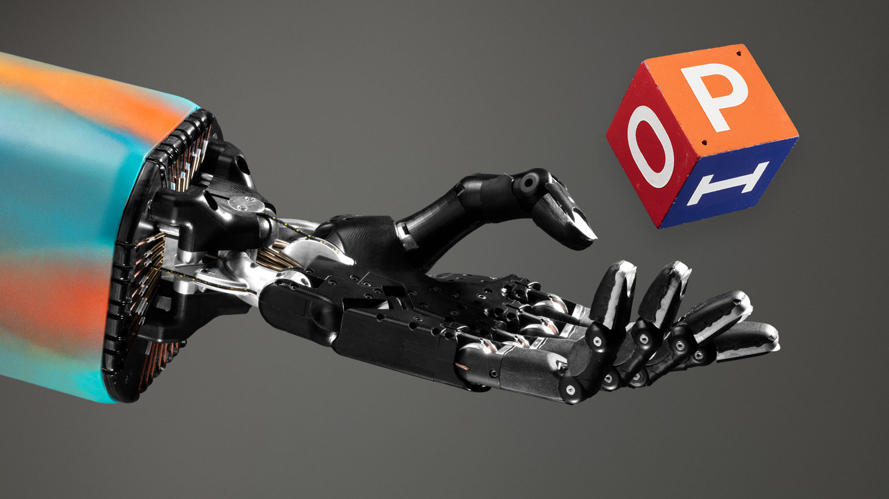
Motivation
Why focus on dexterity?
The human hands are able to solve a huge array of tasks
The world is built around human hands
OpenAI’s goal is built a general purpose robot
Start off interacting with environment and utilizing dexterous manipulation

Slide 3
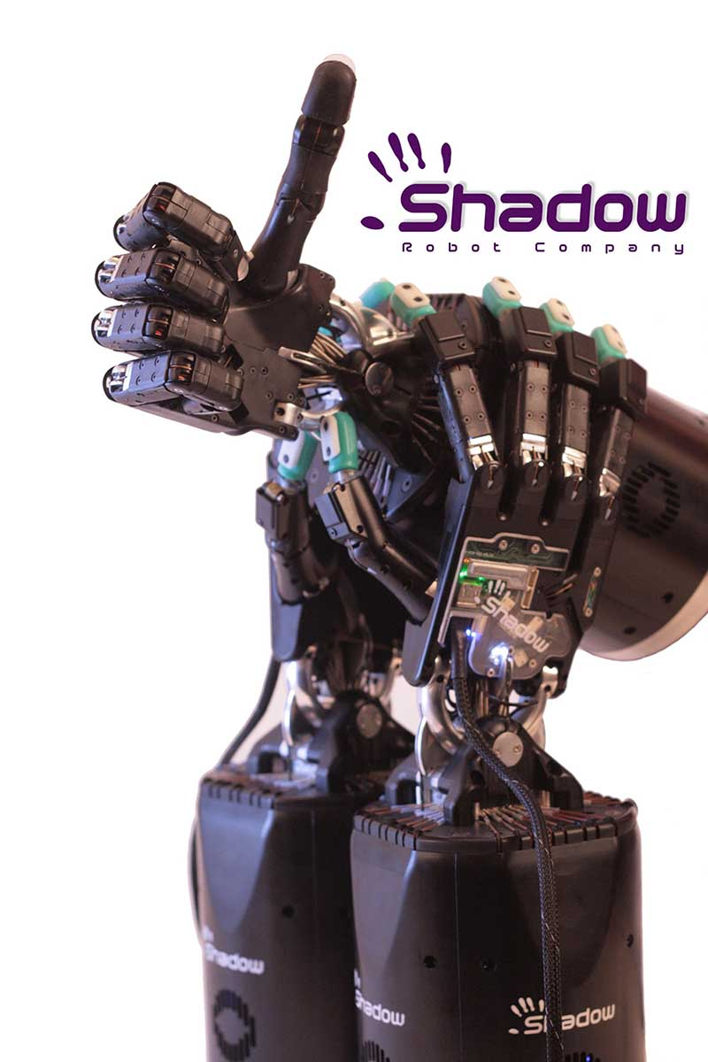
Difficulties with Dexterous Manipulation
OpenAI uses the Shadow Dexterous Hand
24 Degrees of Freedom (7 typically)
20 Actuators
Real-world Hardware
Hard to simulate

Slide 4
Related Works
Dexterous Manipulation
Active area of research for decades, with many strategies
rolling, sliding, finger gaiting, pushing, etc.
However, required planning and exact models of hand and object
Dexterous In-Hand Manipulation
Promising in-hand manipulation in simulations, but do not transfer to real-world robot
Training on physical robots are slow and learning is limited due less training data
Simulation to Real Transfer
Domain adaptation methods
Domain randomization for policy to be more adaptive
Adversarial Training for more robust policies and can help with transfer

Slide 5
Proposed Approach
Goal: Using a humanoid hand, orientate a block to desired orientation
Utilize Reinforcement Learning to train a policy
Requires a lot data
Unfeasible with physical robots (very hard to scale)
Instead let try to simulate it first, then later transfer it to the physical robot

Slide 6
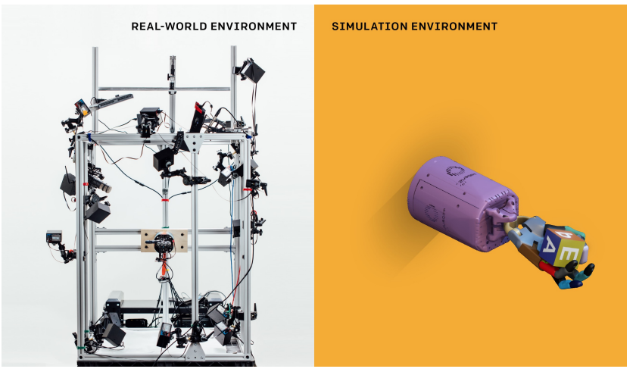
Simulated vs Real
The right image is the simulated environment using MuJoCo Physics Engine.
The left image is the physical world environment. The hand is in the center of the “cage”. The red circle are the RGB camera used for position and object pose estimation.
The simulated environment is model after the physical environment to mimic experiences the robot should have.

Slide 7
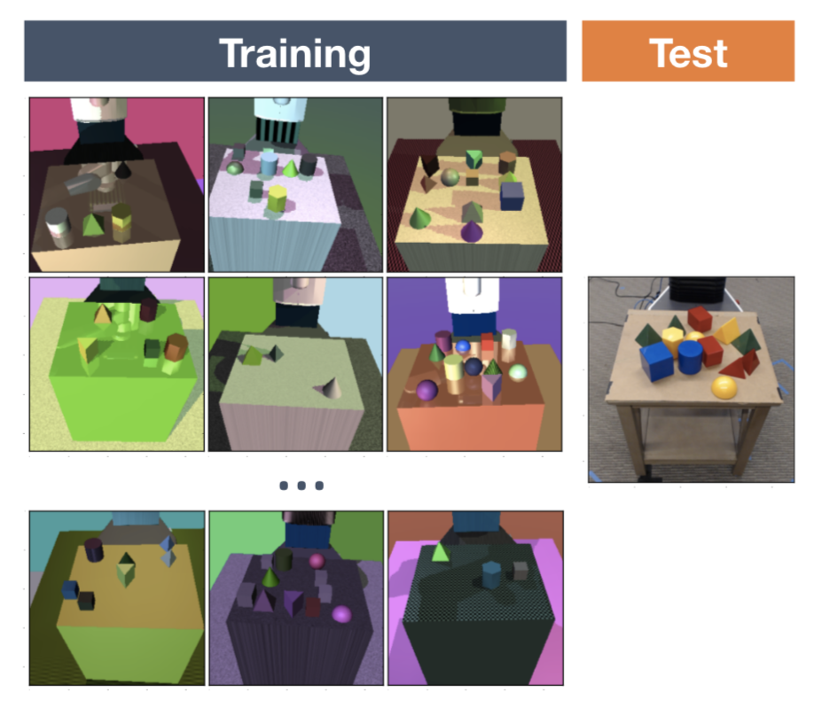
Reality Gap
A simulated model can never be an exact replica of the physical model.
In general, policies trained in simulation perform poorly in the real world (the Reality Gap).
Domain Randomization:
randomize certain aspects of a simulated environment
train policies over wide range of environment
avoids overfitting on one specific environment
Key things randomized:
physics randomizations
visual randomizations (Unity rendered images)

Slide 8
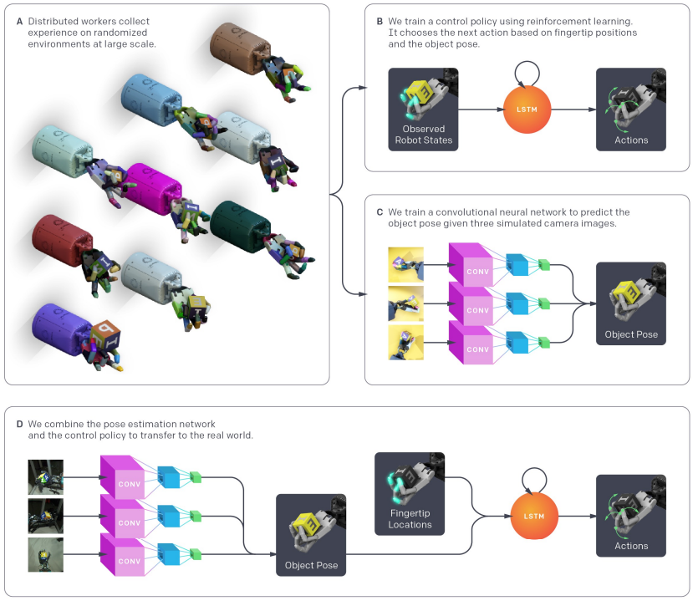
Experimental Setup

Slide 9
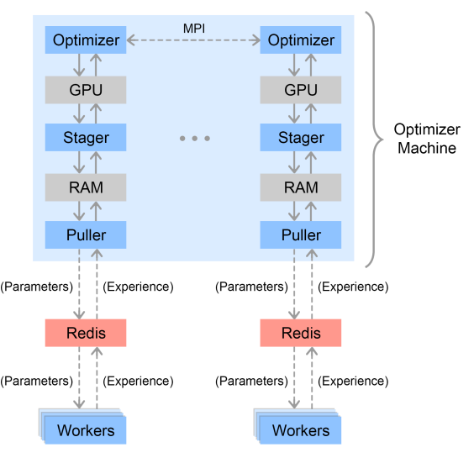
The control policy
Policy represented as RNN with memory
LSTM
Trained with PPO
Actions and Rewards
r_{t} = d_{t} - d_{t + 1} (rotation angles)
+5 for goal is achieved
-20 for dropping the object
Internal framework: Rapid
Used in OpenAI Five
Train policy and vision models
Policy is trained with states (not images)
8 GPUs were used. Pools contained 384 worker machines and each with 16 CPU cores. 6144 CPU cores in total

Slide 10
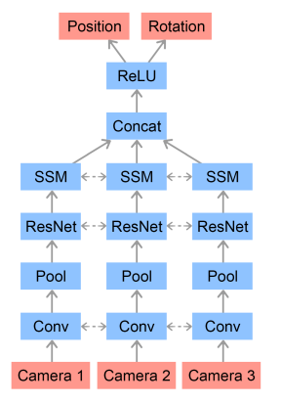
Vision Model
3 RGB cameras with different angles
predicts position and orientation
feed the pose estimator’s prediction to policy
Training
trained policy until 1 million states
Use 2 GPUs for rendering, 1 GPU for training

Slide 11
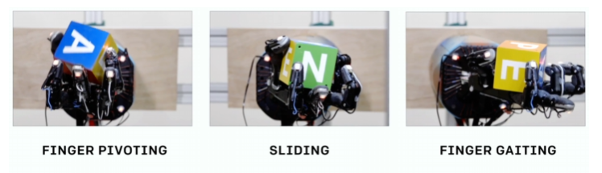
Qualitative Results
The policy naturally exhibit many grasps human do.
Naturally discovered many strategies for dexterous in-hand manipulation.
For precision grasps, the policy tends to use the little finger more than the index and middle finger. Likely due to more DoF.

Slide 12
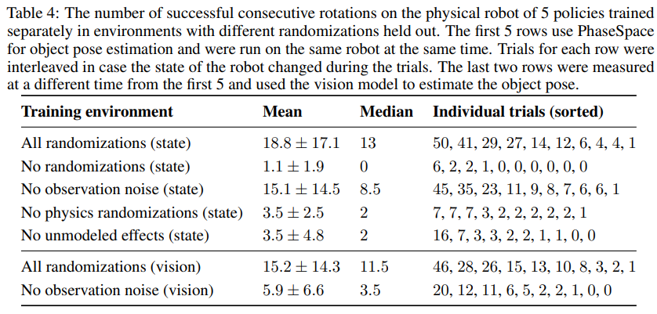
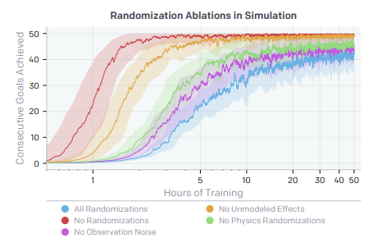
Quantitative Results
Domain randomization is key to the policy performing well

Slide 13
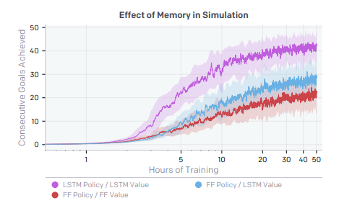
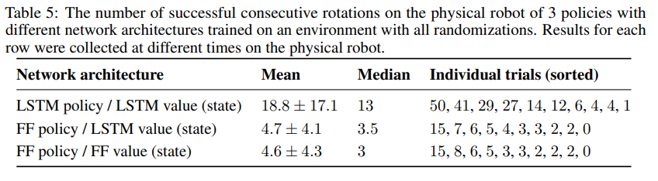
Quantitative Results cont.
Using memory achieve better performance on randomized simulation

Slide 14
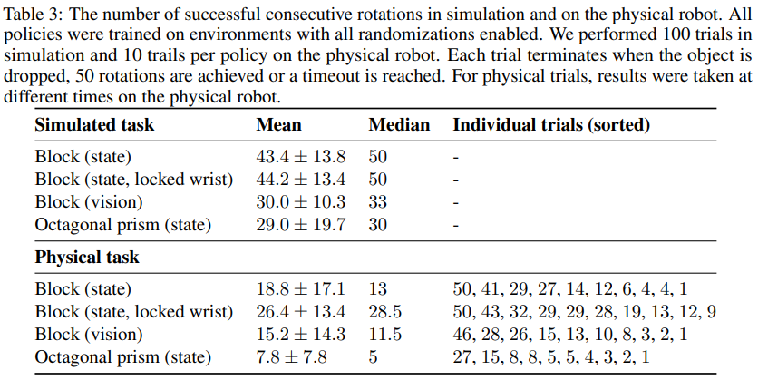
Limitations
Transfer from simulation to physical is still limited.
Failures still occurs
Most common: dropping when rotating the wrist pitch joint down
Dropping the object near the beginning of the trial
Getting stuck because the edge of object gets caught in a screw hole
Hardware is super expensive.
Multiple GPUs and machines.
Shadow Hand price is also extremely expensive!

Slide 15
Future Work / Extended Readings
Solving Rubik's Cube with a Robot Hand. OpenAI et. al (2019)
Same people, added on the challenge of solving a Rubik’s Cube
Utilizes Automatic Domain Randomization
A System for General In-Hand Object Re-Orientation. Tao Chen et. al (2021)
Best Paper Award for Conference on Robot Learning 2021
2000 distinct objects, and pick up objects with hand facing downwards
Dota 2 with Large Scale Deep Reinforcement Learning. OpenAI et. al (2019)
Learn more about Rapid
See how a complex game was broken by an AI

Slide 16
Summary
This paper attempts to train a robot manipulate objects with a 5-fingered robot hands. Due to the complexity of the hardware, prior works were unable to both train the robotic hand and use in the physical world. This paper utilized reinforcement learning and simulations to train the policy. Domain randomization allowed them to generalize the policy and allow it be transfer to the physical world. Using Rapid as the internal framework of the policy and vision model, combining the two allowed the robot physically manipulate objects with relative success.

